Slide 1

Ethical Hacking Presentation
Topics-Who is an ethical hacker and what functions do they perform?
Importance of Ethical Hacking
By Noel Varghese

Slide 2
Who is a hacker?
Whilst hearing the term 'Hacker' ,we can vision a person ,who is good with computers and finds it a pleasure to break into other networks and networks, without authorized permission.
These actions are performed ,either for personal gain or with the sole intention of bringing down an institution/company ,with bad reputation or to simply provide inconvenience.

Slide 3
Continued..
Definition-A computer hacker is a computer expert who uses their technical knowledge to achieve a goal or overcome an obstacle, within a computerized system by non-standard means.
Elaborating on these unethical means ,it refers to performing attacks such as SQL Injections, writing malicious code/algorithms or ransomware.

Slide 4
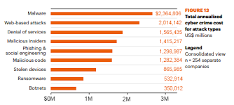
To let that sink in..

Slide 5
Rise of Ethical Hacking
The very act of hacking has an advantage, as it has bred the role of an Ethical Hacker. Simply put ,an ethical hacker is entrusted with the responsibility of finding vulnerabilities that have been overlooked ,on a network of computers or a single system.
These hackers ,point out possible ways that an attacker could target a network/single system and suggest methods to rectify the problems that arise. These help to strengthen existing systems from attacks.
They do their work ,by gaining authorized access to the network ,that needs protection. Ethical Hackers are also known by the term White Hackers.

Slide 6
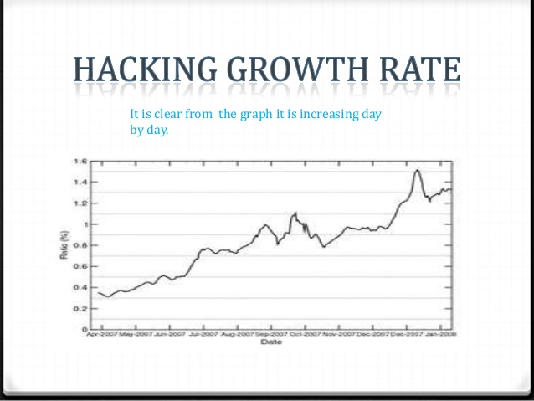

Slide 7
Importance of Ethical Hacking
As discussed in the previous slide, organizations incorporate more and more IT systems into their business in order to aid and facilitate their functions and processes, it becomes necessary for them to test the safety and security of these IT systems.
Small and medium-sized enterprises also known as SMEs, are especially vulnerable to cyber-attacks.
Ethical hacking allows organizations to seek out and correct vulnerabilities and flaws in the security and safety of their computer systems, networks and databases.

Slide 8
Fields that require securing
· Web Application Security
· Security Analysis
· Vulnerability Analysis
· Server Security
Wireless Network Security
Presence of possible backdoors

Slide 9
Function of an Ethical Hacker
Function-Confidentiality
To be discreet about the vulnerabilities discovered after through scan of the network. The information should be confidential, since the same can be leaked out to the customer's competitor institutions, which can cause financial ruin. For this, a mutual trust should be established between the customer institution and the hacker.

Slide 10
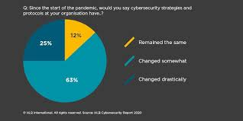
Risk is a step away
Many companies do not recognize the need to secure their systems ,considering it as an unnecessary investment.
On the contrary, it helps immensely in the long run.

Slide 11
India as an example-Worth of prevention is not realized
In India, businesses are faced with the challenge of dealing with complex security requirements that need to be updated as per changing hacking tactics, handling hidden vulnerabilities and evolving technologies. Ethical hacking firms with specially trained professionals come to the rescue of businesses while ensuring effectiveness of service and confidentiality.
While many new businesses are better prepared in case of cyber-attacks, traditional businesses still lack the proactive understanding of the need for ethical hacking. For example, in India, banks having faced the brunt many-a-times are hiring professional help to secure their networks.

Slide 12
Continued
Hotels and other service wings of the industry seem to be lagging behind. Recently, many hotels in the country were being attacked by a malware called 'darkhotel' in an attempt to spy on or stalk corporate travelers and gain access through the hotel's WIFI services.
With new worms, malware, ransomwares and viruses springing up every day, there is a need to create more awareness among businesses and how ethical hacking can help them to safeguard their networks.

Slide 13
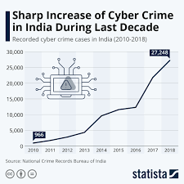
An infographic to realize the grim reality

Slide 14
References
http://panmore.com/ethical-hacking-code-of-ethics-security-risk-issues
https://www.indiatoday.in/education-today/jobs-and-careers/story/ethical-hacking-1047211-2017-09-18
https://www.ukessays.com/essays/information-systems/importance-of-ethical-hacking.php
https://en.wikipedia.org/wiki/Penetration_test
https://www.csoonline.com/article/3238128/what-is-ethical-hacking-and-how-to-become-an-ethical-hacker.html
https://www.simplilearn.com/tutorials/cyber-security-tutorial/what-is-ethical-hacking

Slide 15
Continued
Infographic and Graphs Reference Links:-
https://www.statista.com/chart/22101/number-of-cyber-crime-cases-in-india/
https://image.slidesharecdn.com/ethicalhacking-140123040154-phpapp01/95/ethical-hacking-introduction-22-638.jpg?cb=1391059466
https://hub.packtpub.com/understanding-the-cost-of-a-cybersecurity-attack-the-losses-organizations-face/

